Slide 1

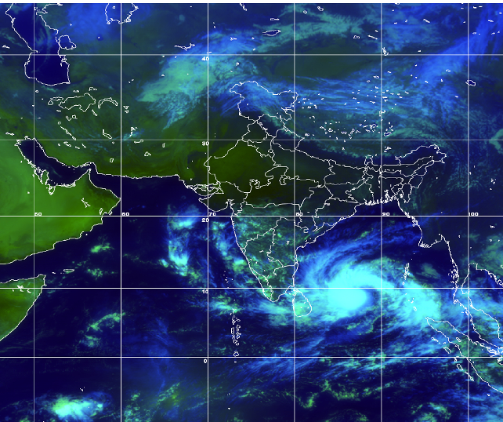
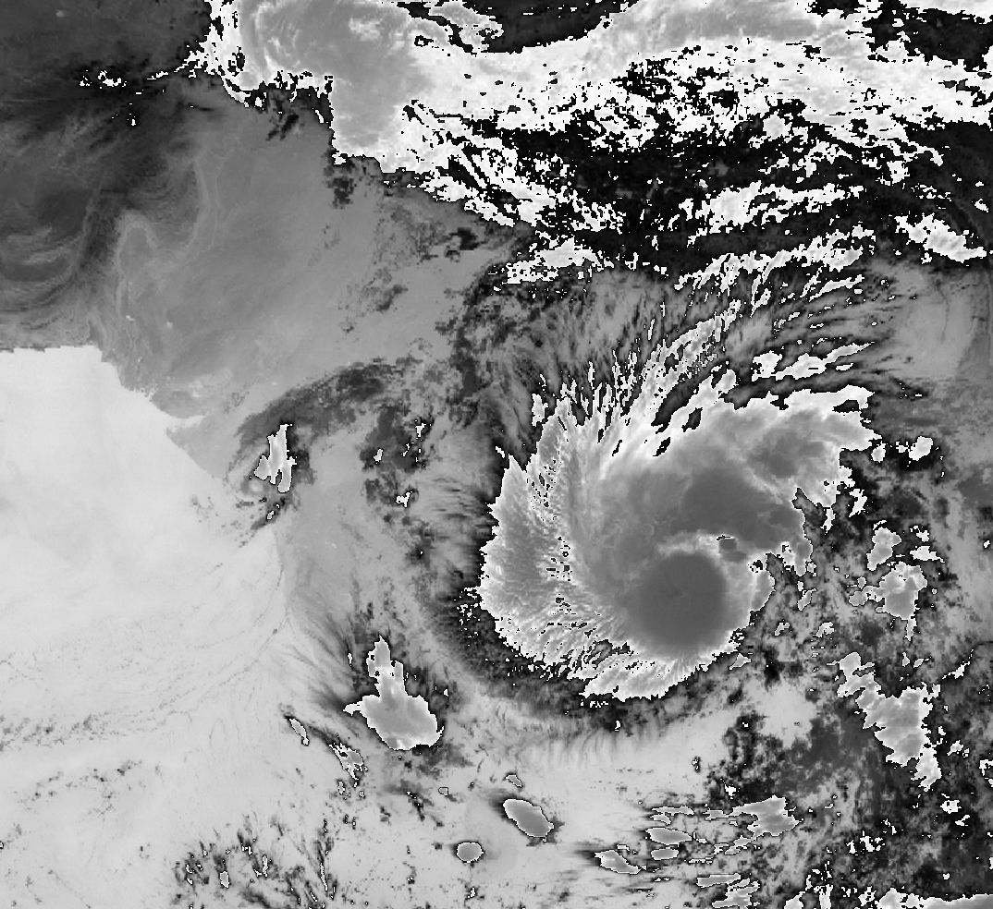
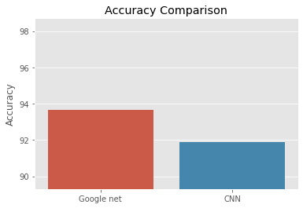
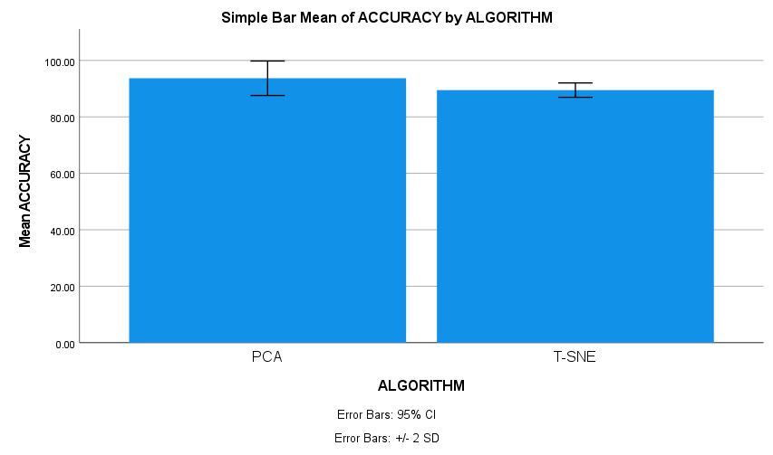
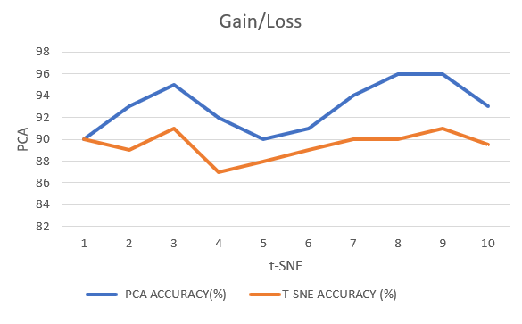
Name: Revanth Alli Register Number: 192110492
Guided by: Dr. T. P. Anithaashri
Ms. Poorani.S
Guided by Dr. Mary Valantina. G
Efficient Prediction of Stargazing the Indian National Satellite System (INSAT) Way Using Principal Component Analysis Algorithm 0ver t-Distributed Stochastic Neighbor Embedding System.
INTRODUCTION
Enhance stargazing prediction efficiency utilizing Principal Component Analysis (PCA) over t-Distributed Stochastic Neighbor Embedding (t-SNE) within the framework of the Indian National Satellite System (INSAT).
Through PCA, we identify key components within downsized INSAT images, refining prediction accuracy while minimizing computational overhead.
Integrating t-SNE allows for detailed spatial visualization despite reduced INSAT image sizes, offering profound insights into celestial phenomena.
PCA reduces data dimensions while preserving essential stargazing features; t-SNE provides detailed spatial visualization, crucial for interpreting celestial phenomena accurately.
INSAT satellite imagery, capturing celestial scenes, serves as the primary dataset for training and testing the prediction model.
Satellite picture showing cloud cover over India
MATERIALS AND METHODS
The Image has been extracted from the Kaggle Website
Reduction of large Images into tiny
PCA compared with T-SNE
Accuracy
93.00%
Python v3.11
Jupyter Notebook
Preprocessing, Training
Validating of image
The Results Analyzed
With
IBM SPSS v25
RESULTS
Algorithm | N | Mean | std.deviation | Std.error mean
Accuracy Principal component Analysis algorithm t-Distributed Stochastic Neighbor Embedding system Algorithm | 10 10 | 93.0040 89.5000 | 3.05687 1.26930 | .96667 .40139
PCA and T-SNE
Statistical Analysis values
Gain and Loss of PCA and T-SNE
In the present work, Principal Component Analysis (PCA) ) is compared with t-Distributed Stochastic Neighbor Embedding (t-SNE) ,it depicts that the proposed algorithm PCA gives more accuracy of 93.00% then t-SNE of 89.50%.
The principal component analysis Algorithm and the t-Distributed Stochastic neighbor embedding system algorithm have the values of the Mean accuracy, Standard Deviation, and Standard Error.
DISCUSSION AND CONCLUSION
According to the study results Principal Component Analysis algorithm outperformed t-Distributed Stochastic Neighbor Embedding algorithm with high accuracy of 93.00% .Based on the independent sample t-test, with the total sample size of 450, the significance value p=0.016 (p<0.05) shows that there is significant difference in the algorithms.
The accuracy of the Principal Component Analysis (PCA) algorithm is 93.00% significantly better than the other algorithm.
Through this research, it is inferred that Principal Component Analysis (PCA) algorithm has high accuracy comparing with t-Distributed Stochastic Neighbor Embedding algorithm for effective analysis on dimension reduction.
Similar findings has been carried with a primary focus on dimensionality reduction, the integration of the Principal Component Analysis (PCA) algorithm with the t-Distributed Stochastic Neighbor Embedding (t-SNE) Algorithm.
BIBLIOGRAPHY
Guleria, Abhishek, and Rakesh Kumar Bajaj. n.d. Technique for Reducing Dimensionality of Data in Decision-Making Utilizing Neutrosophic Soft Matrices. Infinite Study.
Jolliffe, I. T. 2013. Principal Component Analysis. Springer Science & Business Media.
Petkov, Vesselin. 2007. Relativity and the Dimensionality of the World. Springer Science & Business Media.
Lee, Ji-Yong, Kihyeon Kwon, Changgyun Kim, and Sekyoung Youm. 2024. “Development of a Non-Contact Sensor System for Converting 2D Images into 3D Body Data: A Deep Learning Approach to Monitor Obesity and Body Shape in Individuals in Their 20s and 30s.” Sensors 24 (1).
Urrutia, Robin, Diego Espejo, Natalia Evens, Montserrat Guerra, Thomas Sühn, Axel Boese, Christian Hansen, Patricio Fuentealba, Alfredo Illanes, and Victor Poblete. 2023.

